Slide 1

International Comparison Program – ICP
Overview
D.S. Prasada Rao
The University of Queensland

Slide 2
What is ICP?
ICP – International Comparison Program – is a global international statistical initiative designed to provide internationally comparable national accounts aggregates:
  Purchasing Power Parities of currencies (PPPs)
  Real gross domestic product (GDP) which is comparable across countries
  Components of GDP – Private Consumption; Government Expenditure and Gross Fixed Capital formation
  Price levels across countries

Slide 3
ICP Benchmarks – country participation
ICP started as a research project at the University of Pennsylvania by Kravis, Heston, Summers and Kenessey
ICP Phase | Benchmark year | No. of participating countries
I II III IV V VI VII VIII | 1970 1973 1975 1980 1985 1993 2005 2011 | 10 16 34 60 64 117 146 177 (+22)
OECD and Eurostat compile PPPs for their member countries more frequently. Eurostat compiles PPPs compiles PPPs on an annual basis using rolling price surveys.

Slide 4
Purchasing Power Parities (PPPs)
PPPs are amounts of currencies, of different countries, that have the same purchasing power as one unit of a reference currency (e.g. US$) with respect to a selected basket of goods and services.

Slide 5
ICP Governance
United Nations Statistical Commission
ICP Executive Board
Independent Technical Advisory Group
ICP Secretariat
(housed at the World Bank)
Independent Calculation and Results Review Groups
Regional Implementation Agencies
Africa
50
Asia
Pacific
23
CIS
9
LAC
39
Eurostat-OECD
47
Pacific Islands
23
Western Asia
12
Singleton Countries
2
# countries

Slide 6
ICP Workflow
Country
Statistical
Offices
Computation of regional results
ICP Secretariat
(World Bank)
Price collection and expenditure data compilation
Regional Implementing Agencies
Linking regional results to produce global results

Slide 7
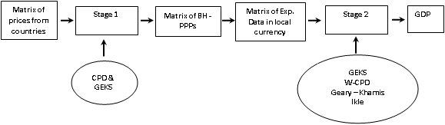
ICP within a region : A Schematic Diagram

Slide 8
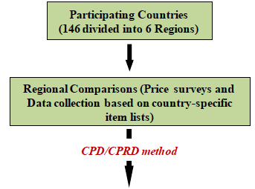
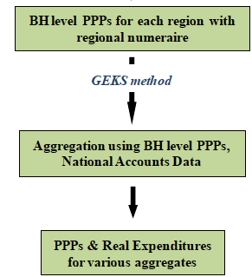
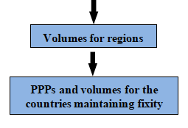
Framework for PPPs – ICP Approach
Global linking
Global Core prices
Linking Factors
Productivity Adjustment
GEKS for the whole world
Fixity
Country Aggregation and Redistribution (CAR) method

Slide 9
ICP/PPP Data Requirements
Price data requirements
  National annual average prices for household consumption items - for example, “white rice” under basic heading “Rice”
    Approx. 620 global core list products
    Supplemented with additional approx. 1000 region-specific products
Price data for special surveys covering other GDP components: Housing; private education; government compensation; machinery and equipment; and construction
  Price data must be consistent with national accounts measurements
National accounts expenditure data requirements
National accounts expenditures for 155 headings

Slide 10
ICP/PPP Key Concepts
Product characteristics
Representative/importance: products prices reflect purchases in the region/country
Comparability: products are sufficiently similar (and well-defined) for inter-country comparisons
Expenditure characteristics
Conform to System of National Accounts concepts , definitions and valuation methods
Reflect total volumes of transactions for goods and services in the country

Slide 11
ICP Classification
Expenditure Levels
Gross Domestic Product
7 Main Aggregates
Individual consumption by households
Individual consumption by government
Gross fixed capital formation
Published
Food & Non-Alcoholic
Beverages
Alcoholic Beverages & Tobacco
26 Categories
Alcoholic Beverages & Tobacco
Food
61 Groups
Food
Non-Alcoholic Beverages
Unpublished
Bread & Cereals
Meat
Fish
126 Classes
Bread & Cereals
Meat
Fish
155 Basic Headings
Rice
Bread
Pasta

Slide 12
DEFINING PRODUCTS
Structured product descriptions (SPDs) provide a structured method for systematically describing all price-determining characteristics for every possible product consumers can purchase. These characteristics are used to define the different kinds of milk, for example, that can be purchased.
(SPD parameters)
Code
Name
Quantity
Brand name
Packaging
Product characteristic
1101141 | Fresh milk | Number of units | Unit of measurement | Min | Max | Brand | Packaging | Processing | Fat content | …
110114101 | Milk, un-skimmed Pasteurized | 1 | Liter | 0.8 | 1.5 | Well known | Pre-packed; carton | Pasteurised; HTST (High Temperature/Short Time) treatment | Natural (3-4%) | …
110114102 | Milk, un-skimmed UHT | 1 | Liter | 0.5 | 1.5 | Well known | Pre-packed; carton | Ultra High Temperature (UHT) | Natural (3-4%) | …

Slide 13
Survey Framework
3 main sampling aspects of the household consumption price survey
1
Stratifying a country to ensure all geographical locations are covered
2
Selection of individual outlets within identified geographical locations
3
Selection of products to be priced
Stratifying a country
Country/Economy A
Region A
Region B
Urban
Rural
Urban
Rural
City A
City B
Village A
Village B
City C
City D
Village C
Village D

Slide 14
Selecting Outlets
Outlet Definitions
Specialized Shops
Private Service Providers
Public or Semi-Public Service Providers
Other Kinds of Trade
Large Shops
Medium and Small Shops
Markets
Street Outlets
Bulk and Discount Shops
Type
Example
Definition
Medium and Small Shops
Minimarkets, Kiosks, Neighborhood shops, Grocery stores, Convenience stores, etc.
Neighborhood shop: The purpose of the retail shop is to blend in with the surrounding neighborhood and focus on local tastes and needs

Slide 15
Price Surveys in China - ICP 2011
The International Statistical Information Centre under the NBS established the ICP Division to oversee all matters relating to ICP.
    Survey Design
    Data aggregation
    Technical assistance for local offices
    Liaising with international organizations including Asian Development Bank and the World Bank
ICP price collection used:
    Statistical Infrastructure for ICP price collection
    CPI survey organization
    Sample Outlets etc

Slide 16

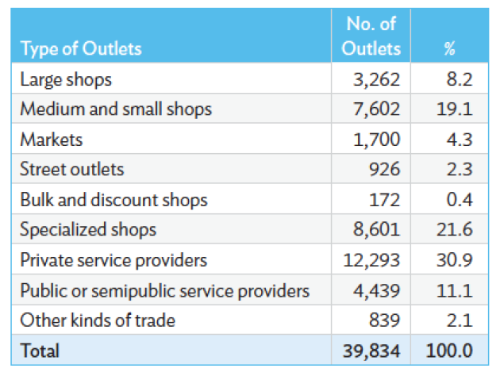
Price Surveys in China – ICP 2011
Source: ADB (2015)
Price surveys in China for 2011 ICP are extensive and have a national coverage. This is in contrast to limited surveys in 2005 ICP covering only 11 capital cities and surrounds.

Slide 17
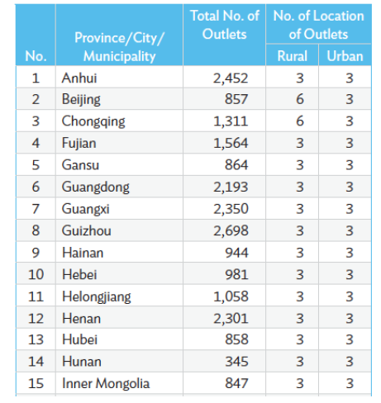
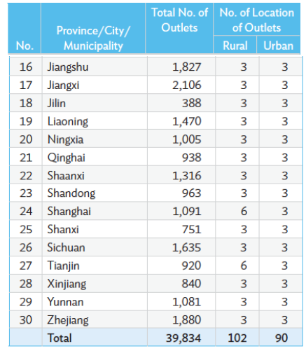
Price Surveys in China – ICP 2011
Source: ADB (2015)

Slide 18
Price Surveys in India – ICP 2011
ICP activities in India were conducted by the Prices Unit of the National Accounts Division, Central Statistical Office.
  Consumption surveys were conducted by the National Sample Survey Office
  Prices were collected by the Central Public Works Department
Infrastructure for ICP Data collection
  CPI infrastructure (outlets, markets, etc.)
  Since ICP specifications are different from CPI products, separate questionnaires were used.
Survey framework
  Prices for food, clothing and footwear - quarterly
  Prices for fruits and vegetables – monthly
  Other household items – twice a year

Slide 19

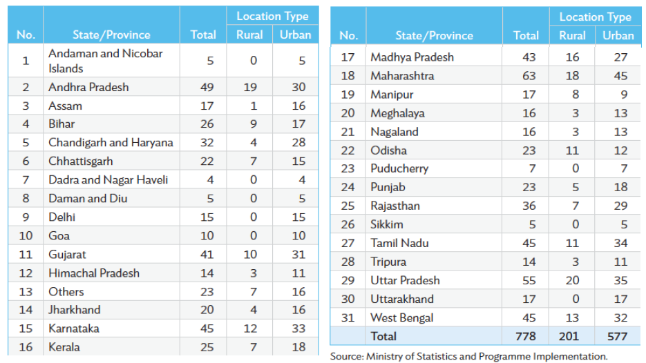
Price Surveys in India – ICP 2011
Source: ADB (2015)

Slide 20
ICP 2011 Results – an overview

Slide 21
PPPs from ICP 2011
(selected countries)
Country | Exch. Rate US$ | PPP | PLI% (World=100)
P.R. China Hong Kong India Australia Japan Luxembourg Ethiopia Austria | 6.461 7.784 46.67 0.969 79.809 0.719 16.899 0.719 | 3.506 5.462 15.109 1.511 107.454 0.906 4.919 0.830 | 70.0 90.5 41.7 201 173.6 162.4 37.5 148.8
Source: World Bank, 2014, Results from ICP 2011.

Slide 22
ICP 2011: 12 Largest Economies in 2011
Ranking by GDP (PPP-based) | Economy | Share of world GDP (PPP-based, world = 100) | Share of world GDP (exchange rate–based, world = 100) | Ranking by GDP per capita (PPP-based)
1 | United States | 17.1 | 22.1 | 12
2 | China | 14.9 | 10.4 | 99
3 | India | 6.4 | 2.7 | 127
4 | Japan | 4.8 | 8.4 | 33
5 | Germany | 3.7 | 5.2 | 24
6 | Russia | 3.5 | 2.7 | 55
7 | Brazil | 3.1 | 3.5 | 80
8 | France | 2.6 | 4.0 | 30
9 | United Kingdom | 2.4 | 3.5 | 32
10 | Indonesia | 2.3 | 1.2 | 107
11 | Italy | 2.3 | 3.1 | 34
12 | Mexico | 2.1 | 1.7 | 72
Source: World Bank, Results from ICP 2005 and 2011.

Slide 23
Ranking of economies by real per capita GDP and Price levels
Ranking by GDP PLI | Economy | GDP PLI (world = 100) | GDP PLI (US = 100) | Ranking by GDP (PPP-based, per capita)
1 | Switzerland | 209.6 | 162.6 | 10
2 | Norway | 206.4 | 160.0 | 7
3 | Bermuda | 201.6 | 156.4 | 9
4 | Australia | 201.0 | 155.9 | 20
5 | Denmark | 185.0 | 143.5 | 21
6 | Sweden | 175.1 | 135.8 | 22
7 | Japan | 173.6 | 134.6 | 33
8 | Finland | 162.6 | 126.1 | 28
9 | Luxembourg | 162.4 | 126.0 | 3
10 | Canada | 161.9 | 125.6 | 23
168 | Cambodia | 42.8 | 33.2 | 146
169 | Uganda | 42.6 | 33.0 | 156
170 | Vietnam | 42.2 | 32.7 | 128
171 | India | 41.7 | 32.4 | 127
172 | Bangladesh | 40.3 | 31.2 | 144
173 | Lao PDR | 39.6 | 30.7 | 133
174 | Ethiopia | 37.5 | 29.1 | 169
175 | Myanmar | 37.0 | 28.7 | 139
176 | Pakistan | 36.4 | 28.2 | 129
177 | Egypt | 35.1 | 27.2 | 97
Source: World Bank, Results from ICP 2011.

Slide 24
ICP 2011: Regional GDP Shares
Source: World Bank, Results from ICP 2011.

Slide 25
Global Distribution of Income: 2005, 2011
Source: World Bank, Results from ICP 2005 and 2011.

Slide 26
Ranking of economies by real per capita GDP and Price levels
Ranking by GDP PLI | Economy | GDP PLI (world = 100) | GDP PLI (US = 100) | Ranking by GDP (PPP-based, per capita)
1 | Switzerland | 209.6 | 162.6 | 10
2 | Norway | 206.4 | 160.0 | 7
3 | Bermuda | 201.6 | 156.4 | 9
4 | Australia | 201.0 | 155.9 | 20
5 | Denmark | 185.0 | 143.5 | 21
6 | Sweden | 175.1 | 135.8 | 22
7 | Japan | 173.6 | 134.6 | 33
8 | Finland | 162.6 | 126.1 | 28
9 | Luxembourg | 162.4 | 126.0 | 3
10 | Canada | 161.9 | 125.6 | 23
168 | Cambodia | 42.8 | 33.2 | 146
169 | Uganda | 42.6 | 33.0 | 156
170 | Vietnam | 42.2 | 32.7 | 128
171 | India | 41.7 | 32.4 | 127
172 | Bangladesh | 40.3 | 31.2 | 144
173 | Lao PDR | 39.6 | 30.7 | 133
174 | Ethiopia | 37.5 | 29.1 | 169
175 | Myanmar | 37.0 | 28.7 | 139
176 | Pakistan | 36.4 | 28.2 | 129
177 | Egypt | 35.1 | 27.2 | 97
Source: World Bank, Results from ICP 2005 and 2011.

Slide 27
Inconsistencies between different ICP Benchmarks

Slide 28
Estimates of real per capita income
ICP 2005 versus extrapolation from 1993
Country | Exch. Rate | ICP-2005 | Extrapolation from 1993
P.R. China Hong Kong India Australia Japan Switzerland Ethiopia | 1,720 26,121 708 34,774 35,607 49,675 154 | 3,957 34,660 2,060 32,798 30,293 35,520 571 | 6,757 34,833 3,452 31,794 31,267 35,633 1,055
Release of 2005 ICP results meant a smaller world size, higher inequality and poverty

Slide 29
Estimates of real per capita income – 2011
(Extrapolations from ICP 2005 and ICP 2011 results)
Country | Extrapolation from 2005 | ICP 2011
Bangladesh China India Malaysia Ghana Ethiopia South Africa Brazil Germany UK | 1,733 8,321 3,677 16,003 1,874 1,030 10,704 11,514 40,980 34,799 | 2,800 10,057 4,735 20,926 3,426 1,241 12,111 14,639 40,990 35,091

Slide 30
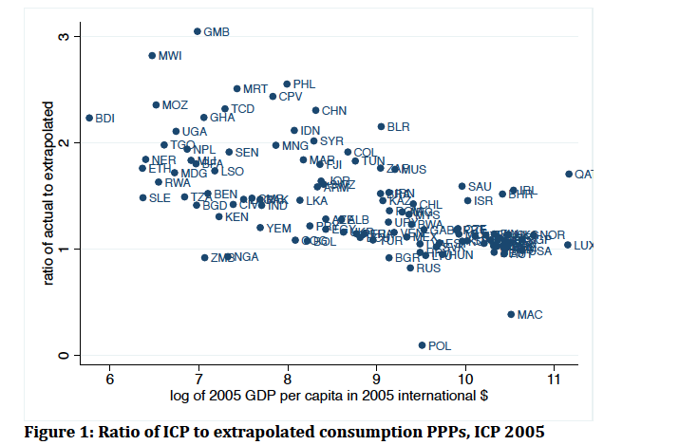
Estimates of real per capita income – 2011
(Extrapolations from ICP 2005 and ICP 2011 results)
Source: Deaton and Aten, 2014

Slide 31
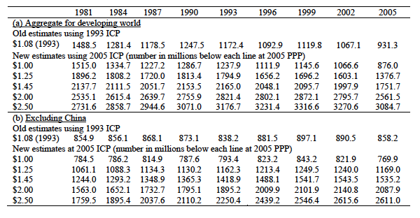
Changes in Global Poverty estimates after ICP 2005
Source: Ravallion and Chen (2010)

Slide 32
Size of the World Economy
(in trillions of dollars)
Source: World Bank, 2014, Results from ICP 2011, 2005 and authors’ calculations

Slide 33
Population weighted Gini measure of International Inequality
 | 2005 | 2011
PPP based Exchange rate based | 0.57 (0.55) 0.71 | (0.52) 0.49 0.64
Source: World Bank, 2014, Results from ICP 2011, 2005.

Slide 34
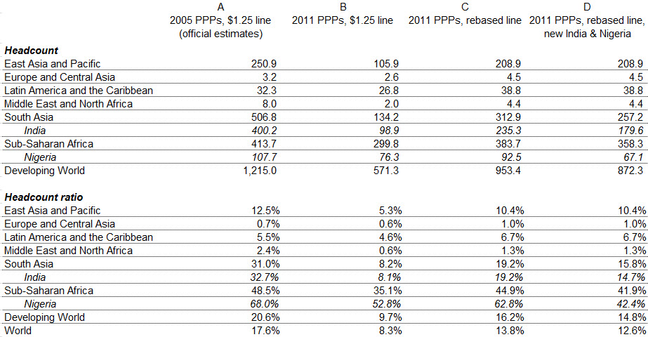
Global and Regional Poverty Estimates for 2010 – 2005 versus 2011 ICP
Source: Chandy and Kharas (2014), Brookings Institute.

Slide 35
Can the differences between ICP 2005 and 2011 be reconciled?

Slide 36
Counterfactual for 2005
Inklaar and Rao (AEJ Macro, 2017)
We make use of data from 2005
Apply the 2011 methodology on 2005 data
We make two types of adjustments:
    Harmonization of methodology
      Aggregation methodology
      Productivity adjustments
      Linking dwellings
      Using country aggregation with redistribution (CAR)
    Addressing price sampling issues
      Correcting for urban bias in China prices
      Correcting for bias in the use of ring products and prices
      Bias due to choice of ring countries
We assess the impact of the adjustments on comparisons and extrapolations

Slide 37
Summary
The ICP has established itself as a major international statistical program under the auspices of the UNSC
During the last two benchmarks, 2005 and 2011, major innovations in the methodology have been introduced including new global linking process
Results from the 2005 and 2011 ICP rounds were quite different compared to extrapolations from their respective preceding benchmarks
    Reconciling benchmarks has been a major task
    Harmonization of methodology
    Accounting for price sampling biases in 2005
The general consensus has been that the 2011 ICP benchmark offers reliable international comparisons.

Slide 38
What is the future of ICP?

